Slide 1

Cutting My Maintenance by 80%
Paresh Motiwala May 26th, 2021

Slide 2
Cutting My Maintenance by 80%
My Contact Details
/in/pareshmotiwala
@pareshmotiwala
Leadership Team:
@Boston_BI -- Business Intelligence User Group
@DBA_VUG-- DBA Virtual User Group
@NESQLServer – New England SQL Server User Group
Circles of Growth

Slide 3
Cutting My Maintenance by 80%
Backups
Staggered Backups
Striped Backups
Parallel Backups with PS
Restores
Striped Restores
Snapshot Replications
Copy Data Virtualization
Checking Database Integrity
Re-Indexing
Rebuilding
Reorganizing
Updating Statistics
Timing Your Maintenance
Third Party Job Schedulers
Planning and Reassessing
Q&A

Slide 4
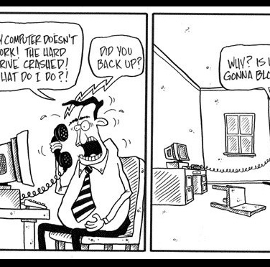
Cutting My Maintenance by 80%
Backups - Staggered Backups
Full Weekly
Differential Daily
Transaction Logs

Slide 5
Cutting My Maintenance by 80%
Backups- Striped Backups – other parameters
Size of DB- 3 TB, compressed-280-GB
Backup Drives- RAID 5
4 Cores 8GB
Stripes | Time | CPU | I/O MBPS | Buffer Count | Block Size | MaxTransferSize | Wait Types
8 | 72 | 97 | 634 | 500 | 65536 | 2097152 | BackupBuffer, Async IO, BackupIO
8 | 76 | 97 | 575 | 800 | 65536 | 2097152
8 | 67 | 95 | 650 | 200 | 65536 | 4194304
4 | 71 | 70 | 615 | 400 | 65536 | 4194304

Slide 6
Cutting My Maintenance by 80%
Backups- Striped Backups – other parameters
Size of DB- 3 TB, compressed-280-GB
Backup Drives- RAID 5
4 Cores 8GB
Stripes | Time | CPU | I/O MBPS | Buffer Count | Block Size | MaxTransferSize | Wait Types
8 | 72 | 97 | 634 | 500 | 65536 | 2097152 | BackupBuffer, Async IO, BackupIO
8 | 76 | 97 | 575 | 800 | 65536 | 2097152
8 | 67 | 95 | 650 | 200 | 65536 | 4194304
4 | 71 | 70 | 615 | 400 | 65536 | 4194304

Slide 7
Cutting My Maintenance by 80%
Striped Backups – More Powerful Machine
Size of DB- 3 TB, compressed-280-GB
Backup Drives- RAID 5
16 Cores 64GB
Stripes | Time | CPU | I/O MBPS | Buffer Count | Block Size | MaxTransferSize | Wait Types
8 | 30 | 65 | 310 | 800 | 65536 | 4194304 | BackupBuffer, Async IO, BackupIO
8 | 45 | 2-5 | 800 | - | - | -
2 | 59 | 2-5 | 613 | - | - | -

Slide 8
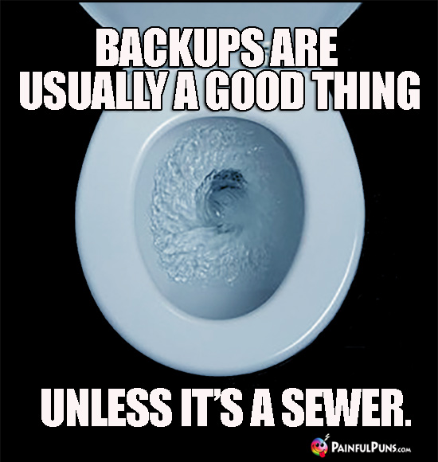
Cutting My Maintenance by 80%
Striped Backups – More Powerful Machine
Size of DB- 3 TB, compressed-280-GB
Backup Drives- RAID 5
4 Cores 8GB
Stripes | Time | CPU | I/O MBPS | Wait Types
1 | 228 | 47 | 211 | BackupBuffer, Async IO, BackupIO
2 | 170 | 70 | 270
3 | 150 | 65 | 310
4 | 137 | 70 | 336

Slide 9
Cutting My Maintenance by 80%
Parallel Backups
Multiple SQL Jobs?
Can this be portable?
Check the capacity of NIC
PowerShell
https://www.mssqltips.com/sqlservertip/4974/backup-sql-server-databases-in-parallel-with-powershell/#comments

Slide 10
Cutting My Maintenance by 80%
Striped Restores
Size of the database: 2.8 TB: Instant File Initialization Enabled
Files | Read/Write | Time (Mins) | Latency 1 | Duration | Latency 2 | Duration | Latency | Rest of the time | Wait Types | CPU | I/O MBPS
4 | X/X drive | 96 | 36 | 10 | 23 | 86 |  |  | BackupIO, BackupThread | 5% | 376
2 | X/X drive | 105 | 2173 |  | 2226 |  | 2470 | 30 | BackupIO, BackupThread | <5% | 361
8 | X/X drive | 109 | 370 | 2 | 4 | 12 | 50 | 28 | BackupIO, BackupThread | <5% | 372
1 | X/X drive | 115 | 1024 | 1 | 2600 | 1 | 30 | - | BackupIO, BackupThread | <5% | 360

Slide 11
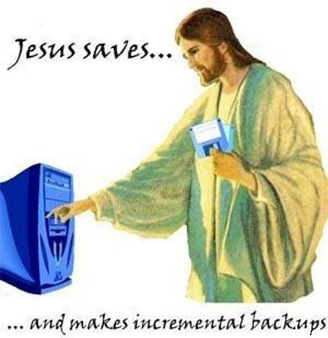
Cutting My Maintenance by 80%
Database Integrity Checks
Frequency?
Daily
Weekly
Against which database?
Prod
Reporting

Slide 12
Cutting My Maintenance by 80%
SnapShot Replication
Daily or user defined
Dependence on infra team
Time- < 5 minutes
Restores
Dependence on infra team
Time- < 5 minutes
Which Server?

Slide 13
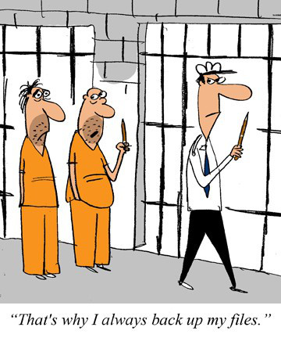
Cutting My Maintenance by 80%
Copy Data Virtualization
Initial Full Ingest
Forever Incremental
Time- < 5 minutes
Restores
Simultaneous copies
Time- < 5 minutes
Which Server?
User driven

Slide 14
Cutting My Maintenance by 80%
Timing
Staggered Re-Indexing
Depends
>30% fragmentation, rebuild ***run on different server?
Stagger over days
Weekends
<30% fragmentation, reorg
Stagger over days
Weekends
Rebuild statistics ?
Shrinking Database
Instant File Initialization
Cleaning After Yourself
https://www.sqlshack.com/sql-server-2016-maintenance-plan-enhancements/

Slide 15
Cutting My Maintenance by 80%
Third Party Job Schedulers(Tidal)
No Programming Skills
Flow and Error Handling
Even DBAs can use it
Interact with everything
Saves time and money
Extended logging
Eliminate humun arrores
Automate

Slide 16
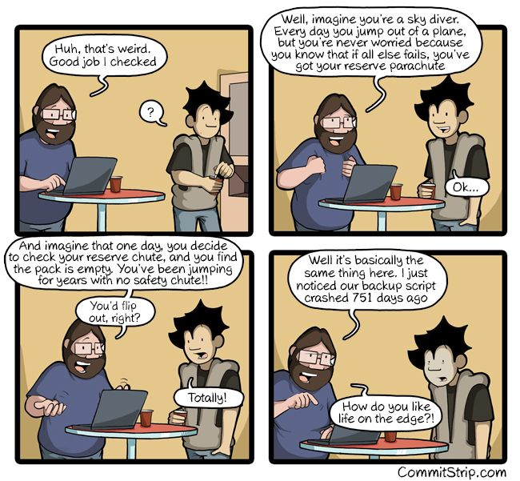
Cutting My Maintenance by 80%

Slide 17
Cutting My Maintenance by 80%
Planning and Reassessing: Look For
Changes in environment
Changes in business requirements
Newer technologies
Downstream
Upstream

Slide 18
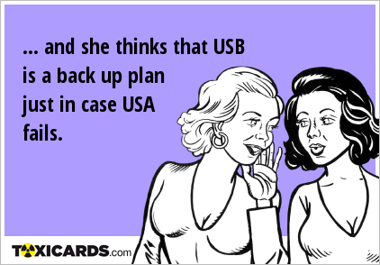
Cutting My Maintenance by 80%
DBA Data Warehouse
Size of backups
Time for backups
Time for re-indexing databases
Growth of disc consumption
Growth of database
Versions of SQL
Last backup completion

Slide 19
Cutting My Maintenance by 80%
Backups
Staggered Backups
Striped Backups
Parallel Backups with PS
Restores
Striped Restores
Snapshot Replications
Copy Data Virtualization
Checking Database Integrity
Re-Indexing
Rebuilding
Reorganizing
Updating Statistics
Timing Your Maintenance
Third Party Job Schedulers
Planning and Reassessing
Q&A

Slide 20
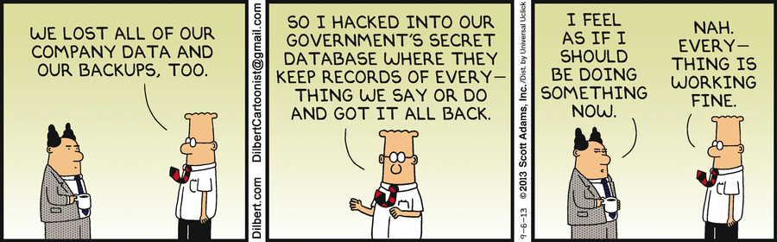
Cutting My Maintenance by 80%
Q&A

Slide 21
Cutting My Maintenance by 80%
Paresh Motiwala
http://www.linkedin.com/in/pareshmotiwala
Twitter: @pareshmotiwala
T H A N K Y O U

